Slide 1

Employing Primitives and Cores In Design
Ehsan Yazdian

Slide 2
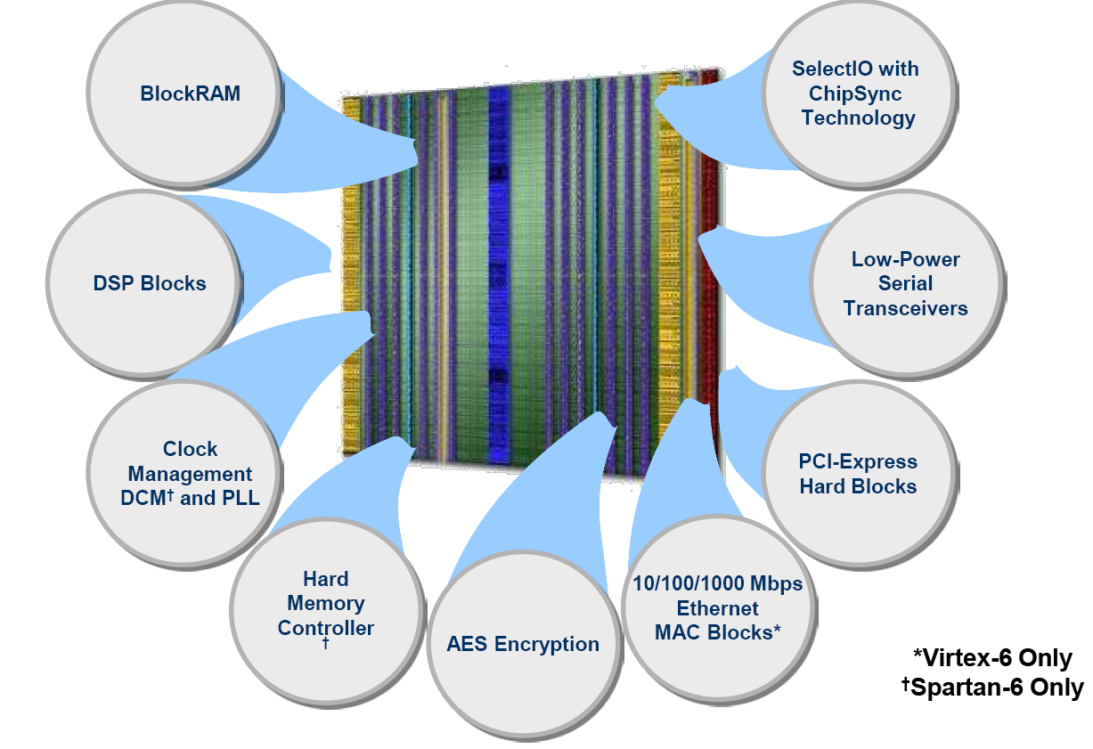
FPGA Dedicated Resources
Primitives: FPGA components that are native to the FPGA you are targeting
These Dedicated resources are faster than a LUT/flip-flop implementation and consume less power
DSP Blocks, FIFO, block RAM, Clock Management DCMs and PLLs, ......

Slide 3
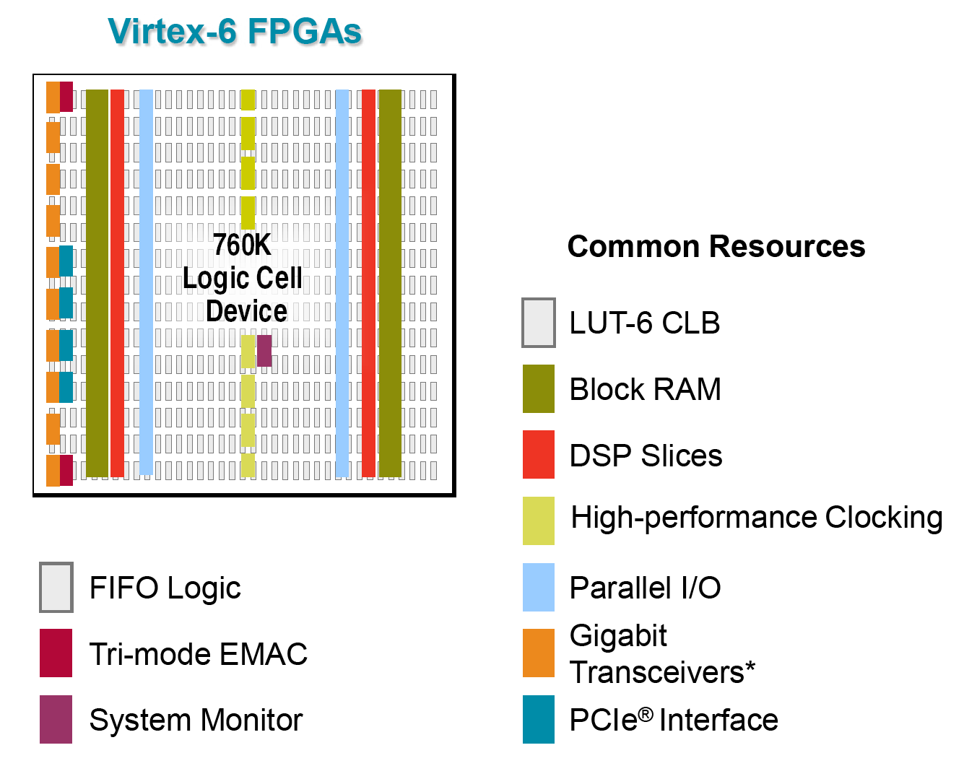
Using Dedicated Blocks
Offers more performance than soft implementations

Slide 4
FPGA Resources
Shift register LUT (SRL16E/ SRLC32E)
Carry logic
DCM / PLL
DSP Blocks
Global clock buffers (BUFG)
Memories
Global clock buffers (BUFGCE, BUFGMUX, BUFGDLL)

Slide 5
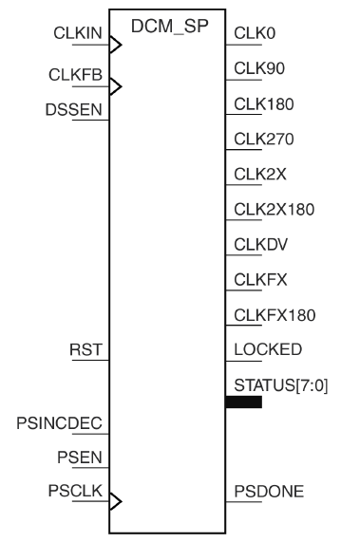
Primitive: Digital Clock Manager
Phase Shifting
provides four phases of the input frequency (CLKIN): shifted 0°, 90°, 180°, and 270°
Frequency Synthesis
generate any output frequency: multiplying Input freq. by M and simultaneously divided by D, where M can be any integer from 2 to 32 and D can be any integer from 1 to 32.

Slide 6
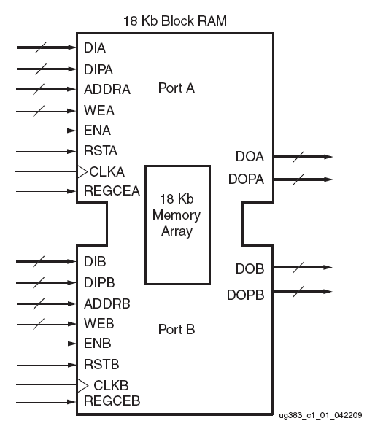
Block RAM
Memory Elements
Can be used to implement FIFOs.
Programmable Data Width
Each port can be configured as 16K × 1, 8K × 2, 4K × 4, 2K × 9 (or 8), 1K × 18 (or 16), or 512 x 36 (or 32).
For example every Spartan-6 FPGA has between 12 and 268 dual-port block RAMs, each storing 18 Kb. Each block RAM has two completely independent ports that share only the stored data.

Slide 7
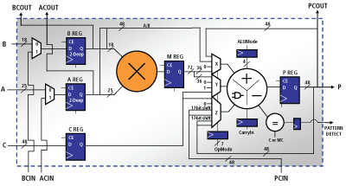
Digital Signal Processing Slices
DSP48 blocks in Xilinx FPGA
Consists of a dedicated 18 × 18 bit two's complement multiplier and a 48-bit accumulator.

Slide 8
Other Resources
Advanced I/O
50 Different Output Standards
GTX transceivers
150 Mbps to 6.5 Gbps
Support many popular high speed standards
PCI express, OC-48, Gigabit Ethernet
Embedded Processor
Some FPGAs has embedded CPU Unit.
Zynq-7000 (SoC): Dual Cortex-A9 ARM Processing System

Slide 9
Other Resources
PLL
Jitter filter for incoming clocks in conjunction with the DCMs.
Voltage-controlled oscillator (VCO) with a frequency range of 400 MHz to 1,080 MHz.
Clock Distribution Resources
High fanout, short propagation delay, and extremely low skew clock lines
For example: 16 global-clock lines in Spartan-6 FPGA.
I/O Clocks
Serial Shift registers, Carry logics, EMAC, .....

Slide 10
Instantiation versus Inference
Instantiate a component when you must dictate exactly which resource is needed
The synthesis tool is unable to infer the resource
The synthesis tool fails to infer the resource
Xilinx recommends inference whenever possible
Inference makes your code more portable
Can be inferred by all synthesis tools
Shift register LUT (SRL16E/ SRLC32E)
Carry logic
Multipliers and counters using the DSP48E
Global clock buffers (BUFG)
I/O registers (single data rate)
Can be inferred by some synthesis tools
Memories
Global clock buffers (BUFGCE, BUFGMUX, BUFGDLL)
Some DSP functions
Cannot be inferred by any synthesis tools
Output DDR registers (Double Data Rate register in I/O blocks)
DCM / PLL

Slide 11
Example
Comparing two implementation of ram
Primitive based (Instantiation)
Coding based (Inference)

Slide 12
Using Cores in the Design

Slide 13
Employing Cores in Your Project
A core is a ready-made function that you can instantiate into your design as a black box
Cores can range in complexity
Simple arithmetic operators, such as adders, accumulators, and multipliers
System-level building blocks, such as filters, transforms, and memories
Specialized functions, such as bus interfaces, controllers, and microprocessors
Some cores can be customized

Slide 14
Benefits of Using Cores
Save design time
Cores are created by expert designers who have in-depth knowledge of Xilinx FPGA architecture
Increase design performance
Cores that contain mapping and placement information have predictable performance that is constant over device size and utilization

Slide 15


Types of Cores
LogiCORE solutions
Fully tested, documented, and supported by Xilinx
AllianceCORE solutions
Sold and supported by Xilinx AllianceCORE solution partners
VHDL and Verilog flow support

Slide 16
Sample Cores
LogiCORE solutions
DSP functions
Time skew buffers, Finite Impulse Response (FIR) filters, transforms, and correlators
Math functions
Accumulators, adders, multipliers, integrators, trig functions, and square root
Memories
Pipelined delay elements, single- and dual-port RAM
Synchronous FIFOs
PCI™ core master and slave interfaces, PCI core bridge
AllianceCORE solutions
Peripherals
DMA controllers, programmable interrupt controllers, and UARTs
Communications and networking
ATM, Fibre Channel, and Ethernet MAC
Error Correction
CTC, 3GPP, Viterbi, and Reed-Solomon
Video and image processing
Standard bus interfaces
PCMCIA, USB, PCI, PCI Express® core

Slide 17
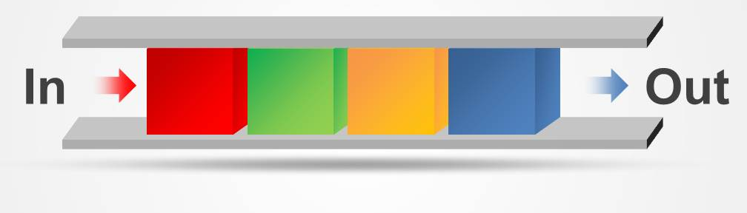
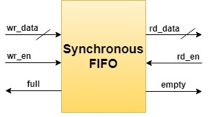
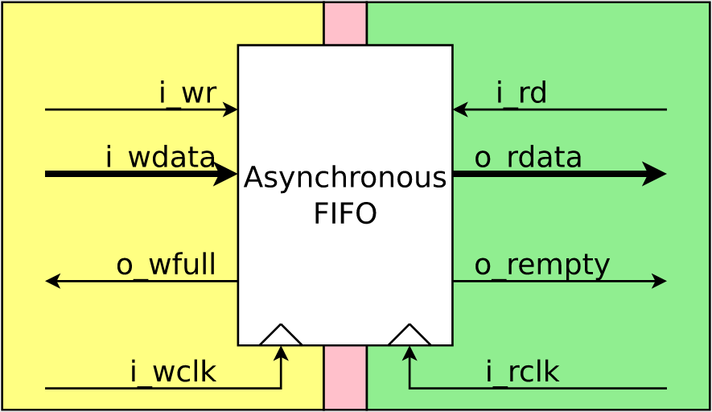
Sample Code using Cores
Employing DCM to generate different frequancies:
Input clk: 24 MHz
Output Clks: 100MHz, 160 MHz
Employing Asynchronous FFIO (First Input, First Output)
Aim: Designing a module to change the rate of data (sample per seconds)
Input data rate: 100 Msps, output data rate: 160 Msps

Slide 18
TOP MODULE
DCM
Input Clk
24 Mhz
Output Clk
160 Mhz
Output Clk
100 Mhz
Async. FIFO
Data Out
Data In
rd_en
wr_en
empty
full

Slide 19
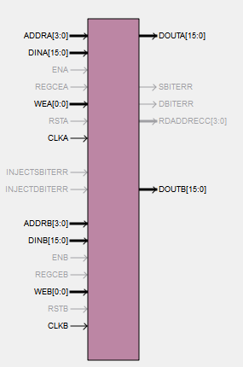
Block Memory Generator Core
Interface Type:
Native
AXI4 Interface
Memory Type:
Single-port RAM
Simple Dual-port RAM
True Dual-port RAM
Single-port ROM
Dual-port ROM
Core Document:
Read Chapter 3, page 54, Operating Mode to learn more about flow of data.
Chapter 7 for how to create core in ISE.

Slide 20
CORE Generator Software System
Graphical User Interface of Core Generator
Data sheets
Customizable parameters
Generate a core
Netlist file (NGC), Instantiation template, Behavioral simulation wrapper files (VHD or V).
Ready for synthesis and implementation and behavioral simulation
The ISE® software automatically uses wrapper files when cores are present in the design
Before your first behavioral simulation, you must compile XilinxCoreLib simulation library
Supports Most of simulation softwares such as ModelSim

Slide 21
Adding A Core to Design
compxlib.exe
Compile library for behavioral simulation (one time only)
XilinxCoreLib
Generate Core
Core generation and integration
.VHD, .V
.NGC
.xco
.VHO, .VEO
Instantiate
Simulate
Implement

